Slide 1
Parent Meeting Agenda:
1) Coach introductions
2) Board introductions
3) Finance/Fundraising
4) Volunteers/Committees
5) Player Expectations
6) Winter Training
7) Spring

Slide 2
Coaching Staff
Head Coach: Troy Spahn
Lead Varsity Asst: John Drury
Varsity Asst: Tom Johnson
Varsity Asst: Jose Arredondo
Varsity Asst: Kyle McFadden
JV Coach: Chris Riley
Soph Coach: Abe Brown
Fresh Coach: Scott Burgess
Fresh Asst Coach: Caleb Burgess

Slide 3
Booster Club Directors
President: Rob Harris
VP: Lori Harry
Secretary: Matt Randgaard
Treasurer: Joe Hogan
At Large: Mindy Scott
At Large: Vacant (See Rob if interested)

Slide 4
Important dates
Jan 8 Winter Training begins (M/F)
Week of Feb 26 Spring Tryouts
Mar 12 First CHSAA games
Mar 19-23 Varsity Trip to Grand Junction
May(date TBD) Booster Club Directors elections

Slide 5
2023-2024 School Year Financials
Revenue
CU fundraiser: $18K
Field Prep: $4K
Kroger: $1K
Winter Program fees: $8K
Spring Fees: $30K
Banners: $1.5K
Spending
Field Leveling: $12K
Winter Program: $16K
Uniforms: $16K
Field equip: $5K
Spring Banquet: $3K
Asst Coaches: $6K
Operating Costs: $5K

Slide 6
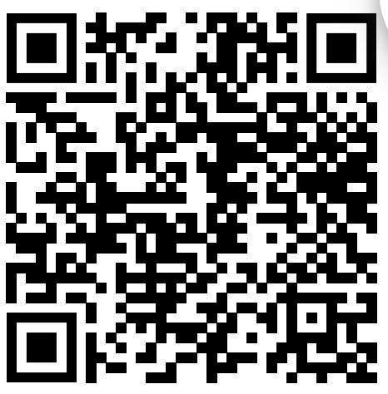
Booster Club Volunteers
We need volunteers for:
Poker Fundraising/Auction
Concession Stand Committee
Sponsorships/Banners
Social Media
Game Day Volunteers
End of Season Banquet

Slide 7
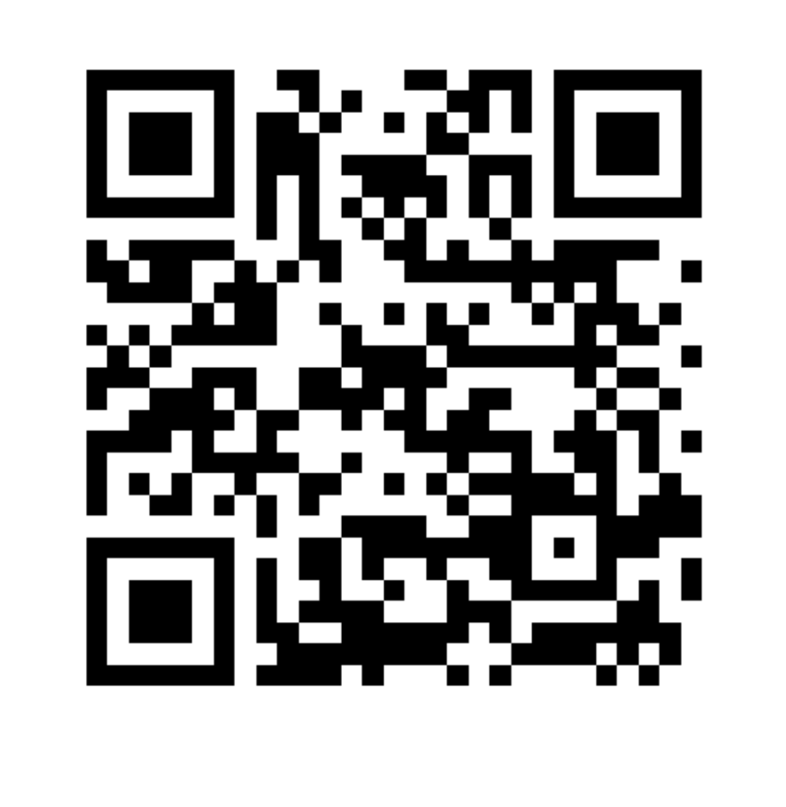
Program Website
https://castleviewbaseball.com
Winter Signup
Can be found
here

Slide 9
CV Gameday 2024 16U summer team
Practice at CV
Cost per player $1500 (discounted from $2000 standard Gameday seasonal fee)
GD Sabercats Uniforms included (2 tops, practice shirt and shorts) pants provided by the player
6-7 local tournaments. We choose the tourney schedule. Mixture of Gameday and CCB events

